Slide 1


HARAMAYA UNIVERSITY
HARAMAYA INSTITUTE OF TECHNOLOGY
SCHOOL OF ELECTRICAL AND COMPUTER
ENGINEERING (COMPUTER STREAM)
BSs THESIS
Enhancing Network Performance: QoS and Congestion Control In Campus Networks
Advisor : Mr. Wehib Abubeker

Slide 2
Outline
Introduction
Background of the study
Statement of the problem
Motivation of the study
Objectives
General Objectives
Specific Objectives
Methodology
Materials and tools
System design
Implementation
Simulation Result And Discussion
Conclusion and Recommendation

Slide 3
Introduction
Background of study
In the modern digital age, where information exchange is pivotal for every facet of academia and business, the efficacy of network infrastructures holds paramount importance.
Within campus environments, the demand for reliable and high-performance networking capabilities has intensified exponentially with the proliferation of online learning platforms, collaborative thesis endeavors, and data-intensive applications.

Slide 4
Cont...
The efficient management of Quality of Service (QoS) and congestion control mechanisms within campus networks emerges as a critical imperative to sustain seamless connectivity, optimize resource utilization, and ensure user satisfaction.
Campus Area Networks provide a simple way for organizations to control their network resources, centralize their security efforts and share data quickly

Slide 5
Statement of Problem
This project focuses on solving the existing problem in campus area network with available resource
To avoid single point of failure we used redundant links so that if one link fail we can access network through another link.
At distribution layer when one switch is active the other is used as standby.
Priority is also configured for important traffic so that when network experience congestion the priority is given for high priority traffic.

Slide 6
Motivation of study
The motivation behind the project stems from the critical need to improve the efficiency and reliability of campus networks.
Aims to develop innovative solutions that can optimize resource utilization.
To contribute to the advancement of network management strategies that can elevate the quality of service delivery in campus environments.

Slide 7
Objective
General Objective
The general objective of this thesis is to enhance network performance within campus environments through the strategic implementation and optimization of Quality of Service (QoS) and congestion control mechanisms using Cisco Packet Tracer
Specific Objectives
To design and implement representative campus network topologies within Cisco Packet Tracer, capturing the diverse network elements
To configure and evaluate Quality of Service (QoS) policies within the simulated campus network, prioritizing traffic.

Slide 8
Cont...
To conduct controlled experiments and performance evaluations within the simulated campus network, measuring key performance metrics such as throughput, latency, packet loss.
To analyze the effectiveness and efficiency of QoS and congestion control mechanisms in enhancing network performance, identifying optimal configurations and best practices for network optimization within campus environments.

Slide 9
Scope of the Project
The scope of the thesis on enhancing network performance through Quality of Service (QoS) and congestion control in campus environments
QoS Mechanisms
Congestion Control Strategies
Evaluation Methodologies
Campus Network Infrastructure

Slide 10
Significance of the Study
Improved user Experience
Enhanced Productivity and Collaboration
Resource Optimization and Cost Reduction
Support for Emerging Applications and Technologies
Contribution to Knowledge and Best Practices

Slide 11
Methodology
Methodology is one of the most important things to be considered to ensure that
the project will run smoothly and achieve the objective.
Project methodology will describe the flow of the project progress.
The project methodology shows us how the project started, how data was collected,
and how the next steps done.

Slide 12
Materials and tools
Several tools and materials were usually needed at different stages of the process in order to design and implementation this project such as:
Routers
Firewalls
Cables
Switches
WLC
Access points
End devises such as Servers, Laptops, Smartphones etc

Slide 13
Campus Network Topology Design
A campus network is generally the portion of the network infrastructure that provides:
Access to network communication services and resources to end users
Devices that spread over a single geographic location.
Designing campus area network
Topology design
Connecting the devices
Configuration

Slide 14
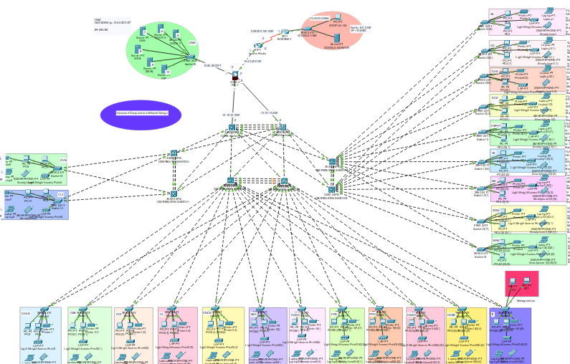
System design
Figure1: Network design for Campus Area Network

Slide 15
Implementation
Basic devices configuration
Step 1: Initial Configuration
Assign a unique hostname to each device.
Configure IP addresses for management interfaces.
Set up basic parameters such as domain name, time settings, and console and VTY line passwords for administrative access.

Slide 16
Cont…
Step 2: SSH Configuration
Generate RSA/DSA keys for SSH encryption.
Enable SSH server and specify version Configure domain name and authentication parameters (local or external AAA server).
Set up SSH version 2 for enhanced security.
Step 3: Standard ACL for SSH:
Create an access control list (ACL) specifically for SSH traffic.
Define the ACL permitting SSH traffic from trusted management hosts.
Apply the ACL inbound on the VTY lines to restrict SSH access

Slide 17
STP port-fast and BPDU guard configuration on all access ports
Identify Access Ports
Enable Port-Fast
Implement BPDU Guard
Verification
Ether-channel configuration
Identifying Member Interfaces
Configuring Ether-Channel Interface
Selecting Ether-Channel Mode

Slide 18
Sub-netting and ip addressing
Sub-netting and IP addressing are crucial for effectively managing and organizing IP networks.
Sub-netting involves dividing a large IP network into smaller, more manageable sub-networks, known as subnets
IP addressing involves assigning unique IP addresses to devices within those subnets
Configuring Static ip address
DMZ/server farm
Firewall interfaces, router interfaces, and SVIs

Slide 19
Configuring a DHCP server device
Configuring a DHCP server device involves several steps and is essential for automating IP address assignment.
Activation
Scope Configuration
Exclusion Ranges
HSRP configuration and Assigning Ip DHCP helper Address
Step 1 Identify VLANs and Interfaces
Step 2 HSRP Configuration
DHCP Helper Address Configuration

Slide 20
Configuring OSPF
Enable OSPF routing on the layer 3 device.
Configure OSPF settings such as router ID, area assignments, and authentication.
Advertise VLAN subnets or SVIs into OSPF.
Establish OSPF neighbor relationships with adjacent routers or SVIs.
Configuring firewall interface security zones and levels
Define Security Zones
Assign Security Levels

Slide 21
Cont…
Define Inter-Zone Policies
Implement Zone-Based Security Policies:
Configuring firewall inspection policies
Threat Detection and Prevention:
Wireless network configuration
Access Point Setup
Wireless LAN Controller Configuration
Connectivity Setup
Device Configuration

Slide 22
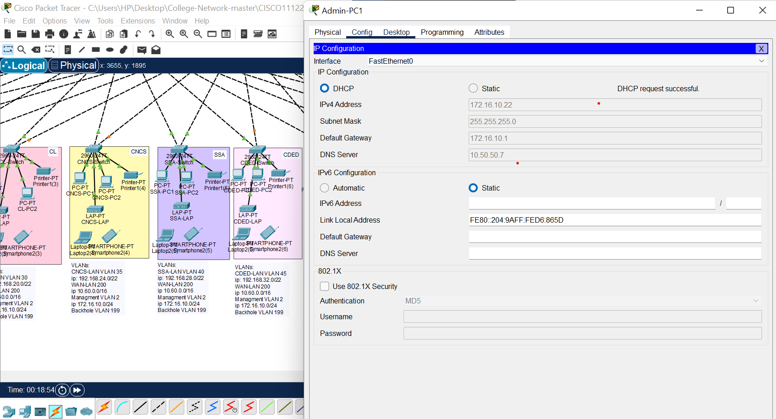
Simulation Result And Discuss DHCP Testing Figure 2:Response of IP address from DHCP Serve Clients PC also get IP address in the same manner.

Slide 23
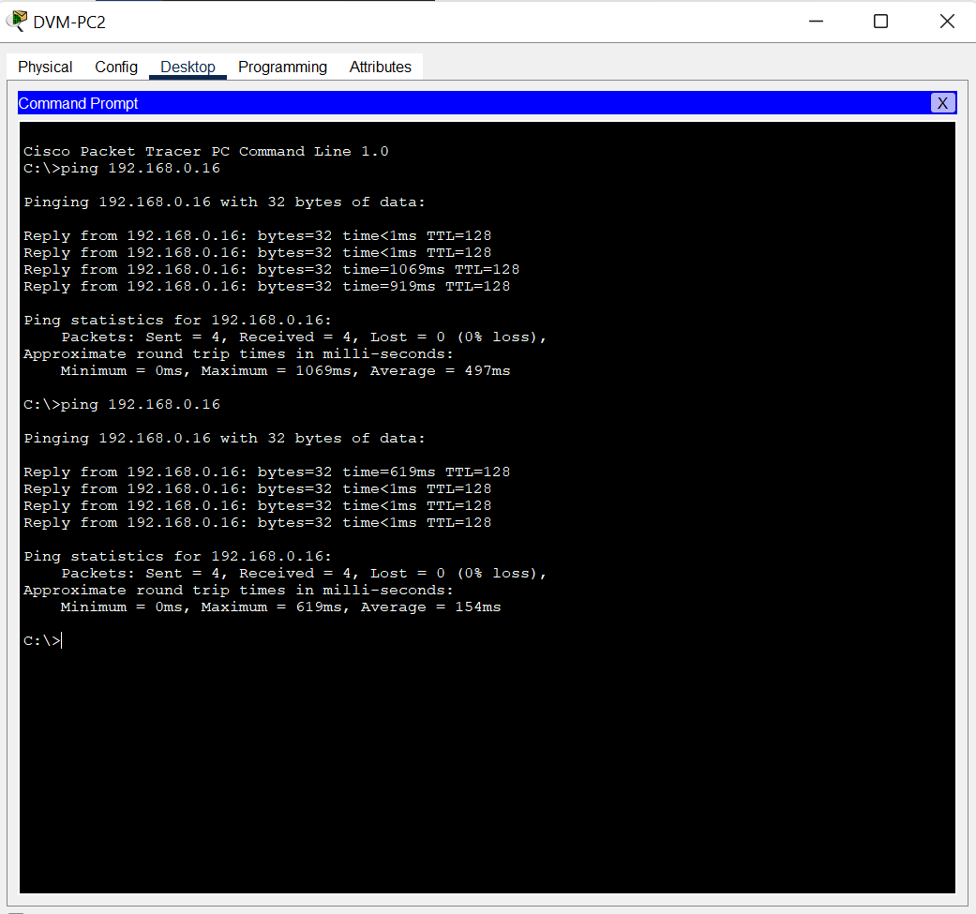
Checking connection between devices
Figure 3: devices are connected in the Campus Area Network

Slide 24
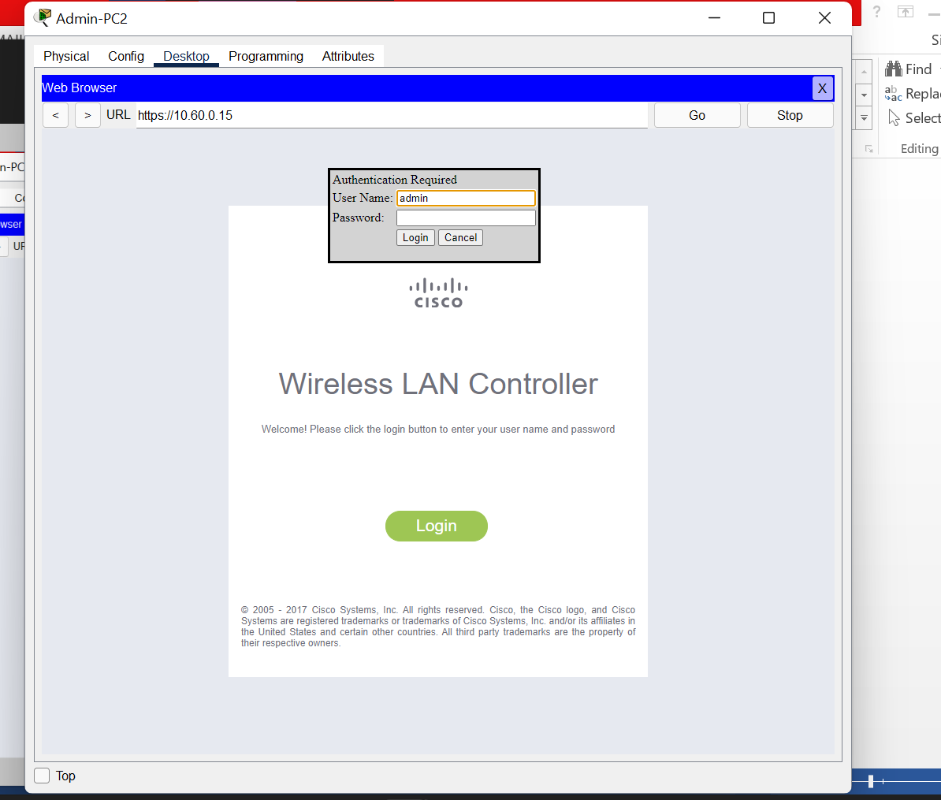
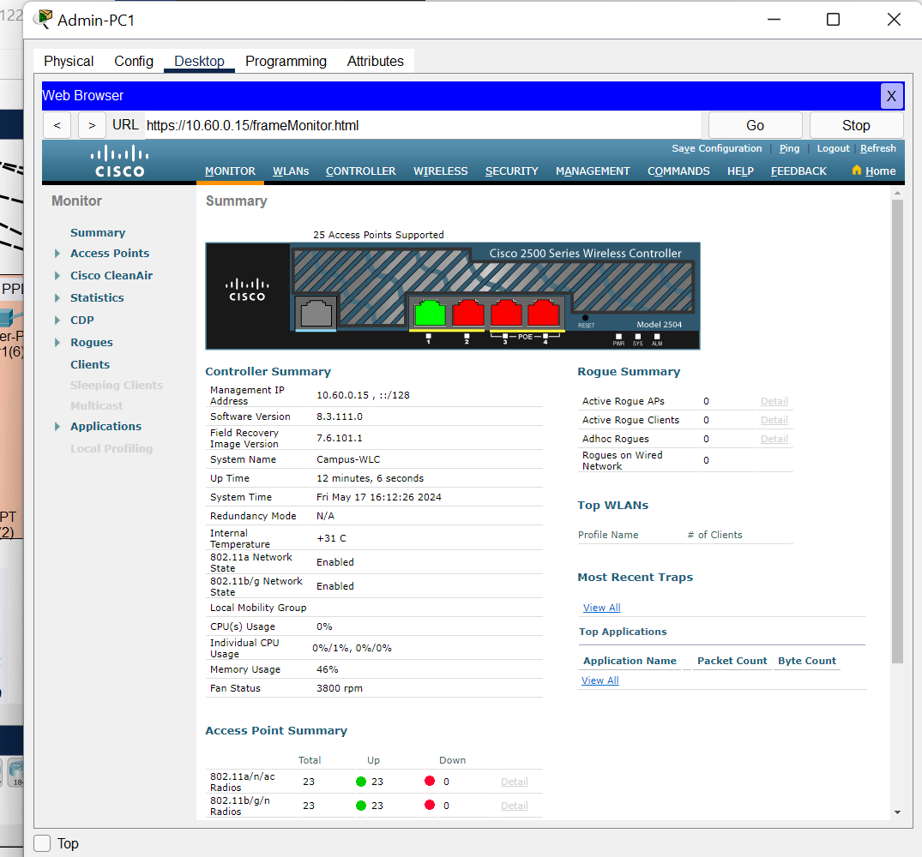
WLAN Controller Testing
Figure 4: Admin login

Slide 25
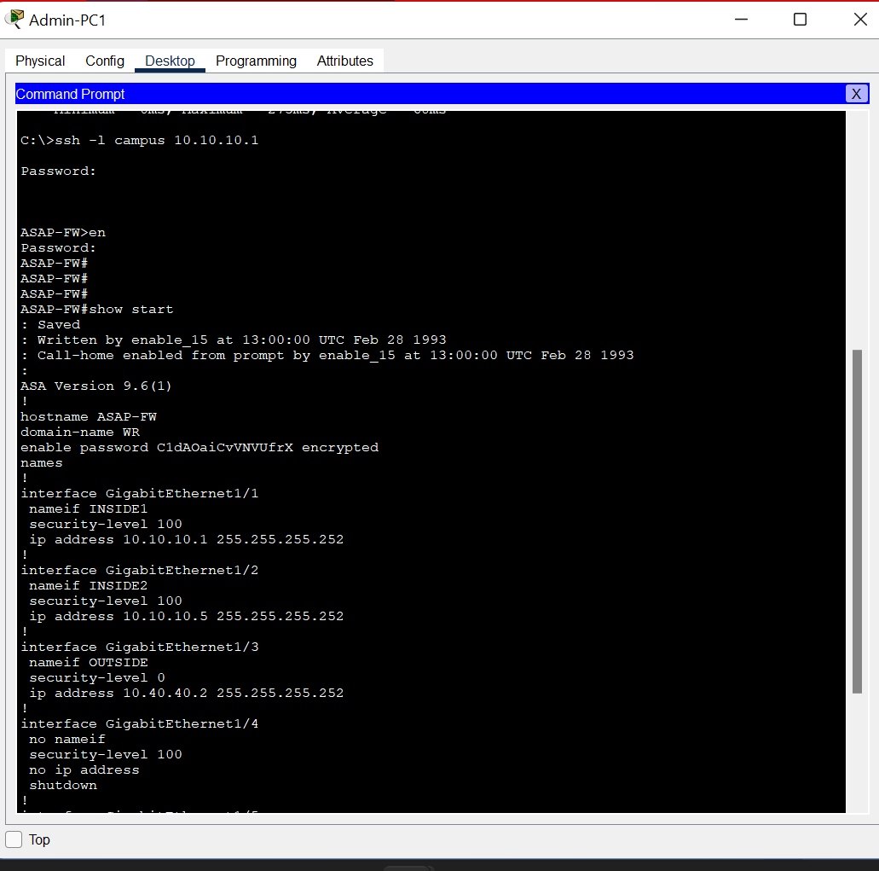
SSH testing
Figure 4: Remotely accessed Firewall

Slide 26
Conclusion and Recommendation
Conclusion
The proposed campus area network design, leveraging redundant links, minimized broadcast domains, high-bandwidth cables.
Redundancy provides a comprehensive solution to address the evolving needs of the educational institution.
Highly detailed control and segmentation promotes better network optimization, security, and resource allocation

Slide 27
Recommendation
To build a robust and efficient campus area network, we would recommend the following:
Redundant Link
Minimizing Broadcast Domain
Departmental VLANs
High Bandwidth Cable

Slide 28
THANK YOU FOR YOUR ATTENTION.

